Slide 1

TUTORIAL WEEK 8: artificial Neural networks - supporting material

Slide 2
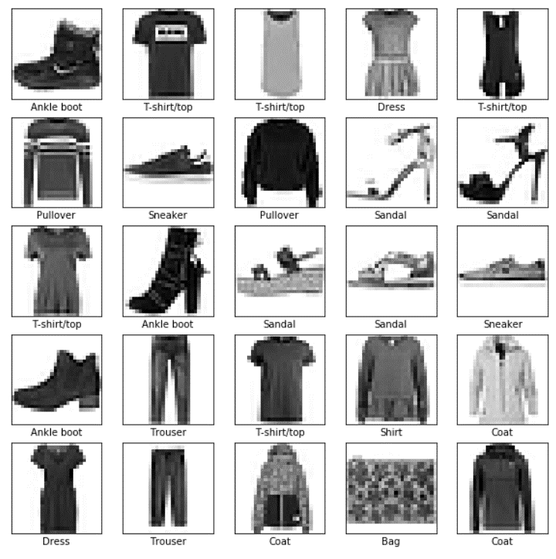
Neural networks: a practical example with tensorflow
Example with TensorFlow
We will work with this example in the Tutorial
import tensorflow as tf import matplotlib.pyplot as plt import numpy as np fashion_mnist = tf.keras.datasets.fashion_mnist (train_images, train_labels), (test_images, test_labels) = fashion_mnist.load_data() class_names = ['T-shirt/top', 'Trouser', 'Pullover', 'Dress', 'Coat', 'Sandal', 'Shirt', 'Sneaker', 'Bag', 'Ankle boot']

Slide 3
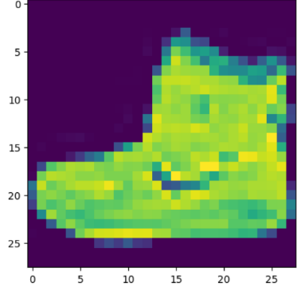


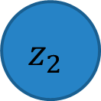
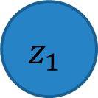
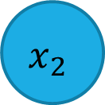

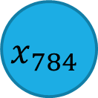
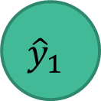
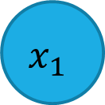

Model creation
$$x_{1}$$
$$z_{1}$$
$${\hat{y}}_{1}$$
$$x_{2}$$
$$z_{2}$$
…
…
…
$${\hat{y}}_{10}$$
$$x_{784}$$
$$z_{128}$$
model = tf.keras.Sequential([ tf.keras.layers.Flatten(input_shape=(28, 28)), tf.keras.layers.Dense(128, activation='relu'), tf.keras.layers.Dense(10) ])
Input = 28*28 = 784
Total trainable parameters: (784*128) + 128 + (128*10) + 10 = 101,770
Hidden layer with 128 units and a ReLu activation function
Output

Slide 4
Set optimiser and TRAINING
Optimiser
Learning rate
model.compile(optimizer=tf.keras.optimizers.Adam(learning_rate=0.00001), loss=tf.keras.losses.SparseCategoricalCrossentropy(from_logits=True), metrics=['accuracy’])
Loss
Validation set
Training set
epochs = 10 history = model.fit(train_images, train_labels, validation_data=[test_images, test_labels], epochs=epochs)
Number of epochs (iterations)

Slide 5
Test & Inference (Prediction)
Softmax to normalise the logits (output) into probabilities
probability_model = tf.keras.Sequential([model, tf.keras.layers.Softmax()]) predictions = probability_model.predict(test_images)
Make prediction
Images to predict
Array of predicted values for each test image

